Slide 1



Software Engineering CS-UH 2012, SPRING 2025
Lecture 12: Construction
Prof. Mohamad Kassab, mk9508@nyu.edu

Slide 2

Lesson plan
Version Control Systems
Version Control using Git
In-class Exercise
Code Review
Issue Tracking Systems
Build Systems
Refactoring

Slide 3


We are now ready to build our system.. but how do we go about it?

Slide 4

What to keep in mind
Golden rules to live by when developing software:
Be organized
Automate everything
Track & Document everything
In this lecture, we will learn some of the tools and methods to keep our development organized and to track its evolution

Slide 5

Version Control System (VCS)
Tracks Changes – Records file modifications over time for version recall.
History Navigation – Enables viewing past changes, contributors, and reverts.
Safe Editing – Allows changes without risking a working version.
Collaboration – Ensures everyone accesses the latest version.
Text-Based Tracking – Works best with textual files but has limitations with formatted documents like .docx and .pptx.

Slide 6
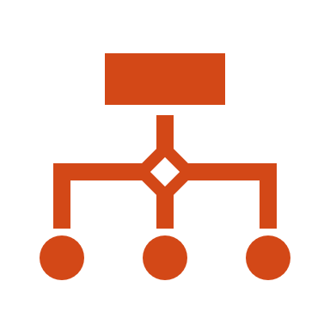
Types of Version Control Systems
Centralized version control systems
Examples: cvs, svn
Distributed version control systems
Examples: git, mercurial

Slide 7
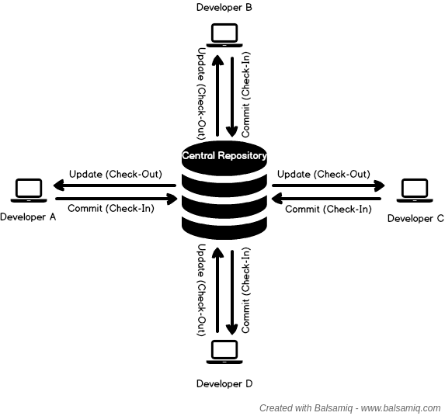
Centralized Version Control Systems
One “central” repository that provides client access to all involved developers.
Think of a client-server relationship
When you commit some changes, you are directly committing to that central repository.
Only the central repository keeps track of the history.

Slide 8
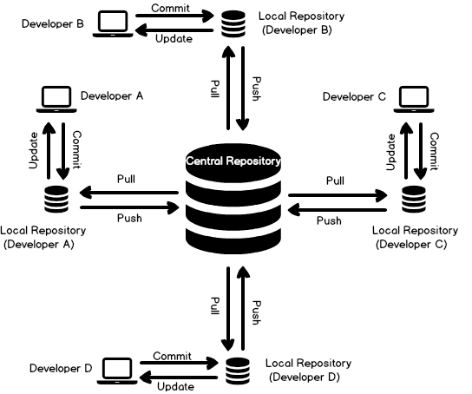
DECentralized Version Control Systems
Each developer has their own local copy of the history
When you commit some changes, you are committing to your local repo.
To commit to the central repo, you need to explicitly push your changes

Slide 9
Advantages of Distributed Version Control Systems
Performing actions other than pushing and pulling changes is extremely fast because you do not need to access the remote server.
Committing new changes can be done locally without anyone else seeing them. Once you have a group of changes ready, you can push all of them at once.
Everything but pushing and pulling can be done without an internet connection.
[Giancarlo Lionetti, https://www.atlassian.com/blog/software-teams/version-control-centralized-dvcs]

Slide 10
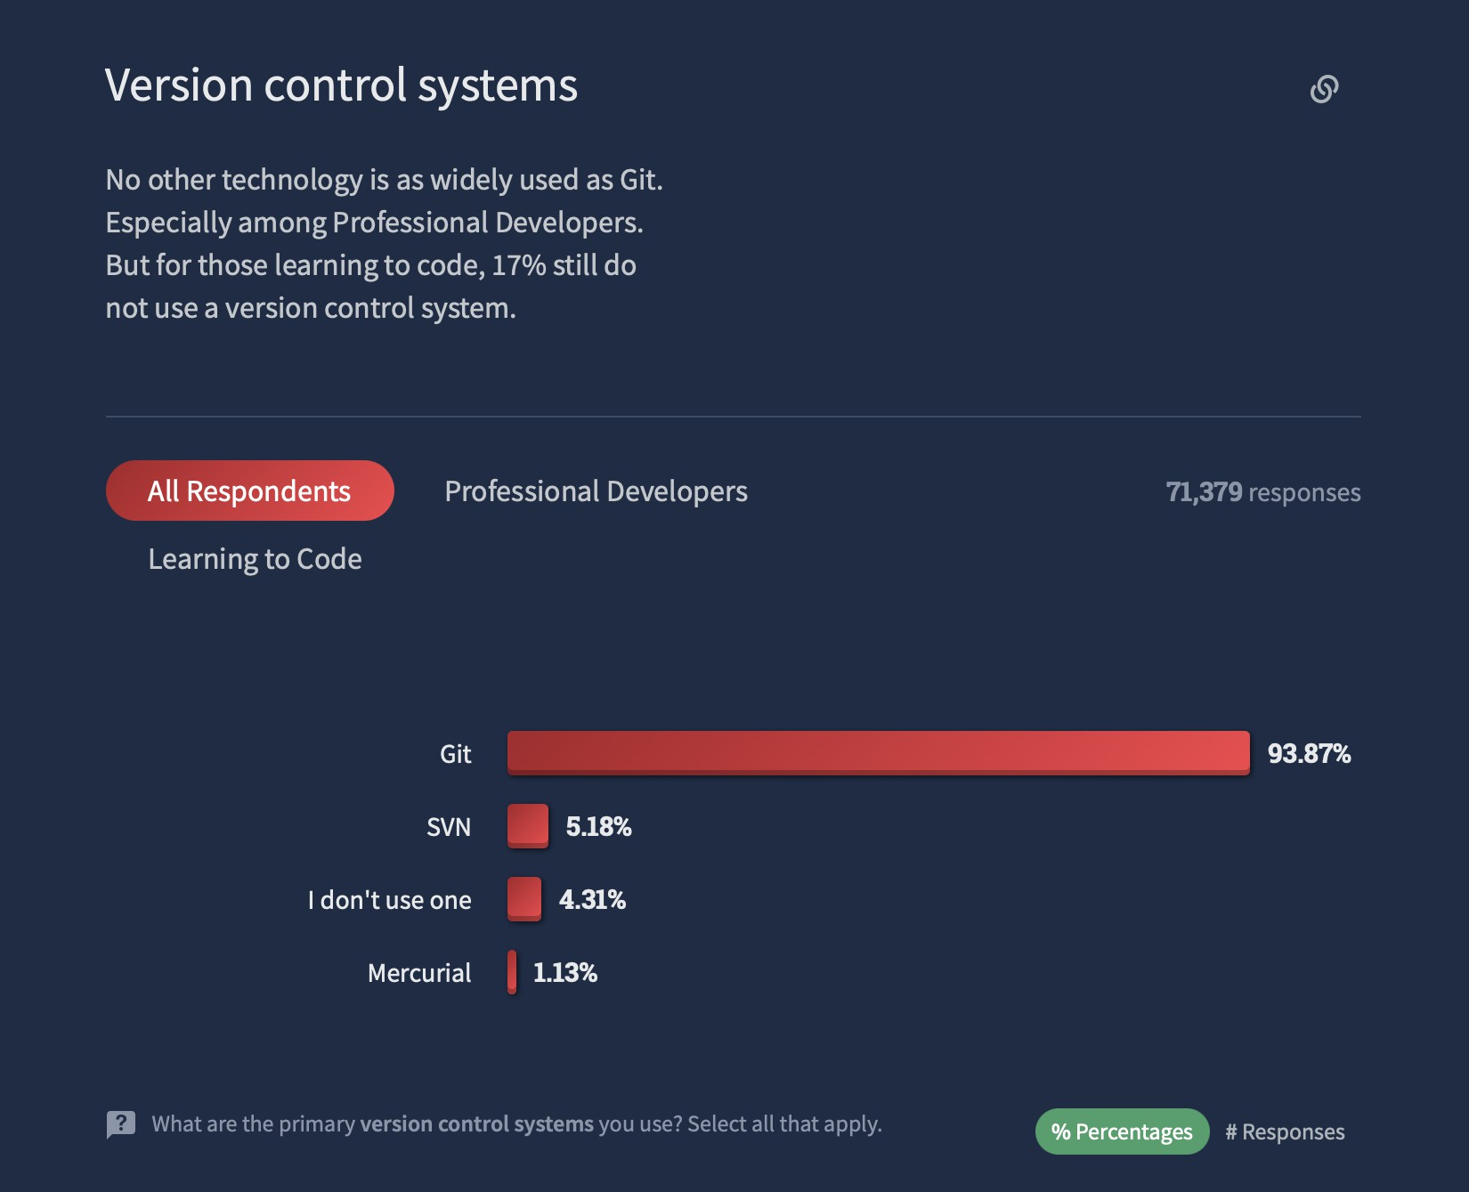
Git is by far the most popular VCS (2022 stats)
https://survey.stackoverflow.co/2022#technology-version-control
We will mainly focus on git in this course

Slide 11







git: Terminology and Workflow
create/modify files
Working Directory
Staging Area
Local Repository
Remote Repository
stage changes
commit
push
Credits: visualization from Frank Tip

Slide 12



git: Terminology and Workflow
Working Directory
Remote Repository
pull
Credits: visualization from Frank Tip

Slide 13
I will focus on accessing git through command lines. You can explore GUI tools on your own.
git: Commands
most commands are of the form
git <verb> <options> <path>
extremely high number of options
many ways to achieve the same thing
git add [--verbose | -v] [--dry-run | -n] [--force | -f] [--interactive | -i] [--patch | -p]
[--edit | -e] [--[no-]all | --[no-]ignore-removal | [--update | -u]]
[--intent-to-add | -N] [--refresh] [--ignore-errors] [--ignore-missing] [--chmod=(+|-)x] [--] [<pathspec>…]
Example from: https://git-scm.com/docs/git-add
Credits: visualization from Frank Tip

Slide 14







Stage Changes to a File
create/modify
files
Working Directory
Staging Area
Local Remote
Repository Repository
commit push
stage changes
git add <file>
Credits: visualization from Frank Tip

Slide 15







Committing Changes
create/modify
files
Working Directory
Staging Area
Local Repository
Remote
Repository
push
commit
git commit <file(s)> -m <message>
stage changes
Credits: visualization from Frank Tip

Slide 16





Pushing Changes to Remote Repository
create/modify
files
Working Staging
Directory Area
stage changes commit
Local Repository
Remote Repository
push
git push
Credits: visualization from Frank Tip

Slide 17



Pulling Changes from Remote Repository
Working Directory
Remote Repository
pull
git pull
Credits: visualization from Frank Tip

Slide 18
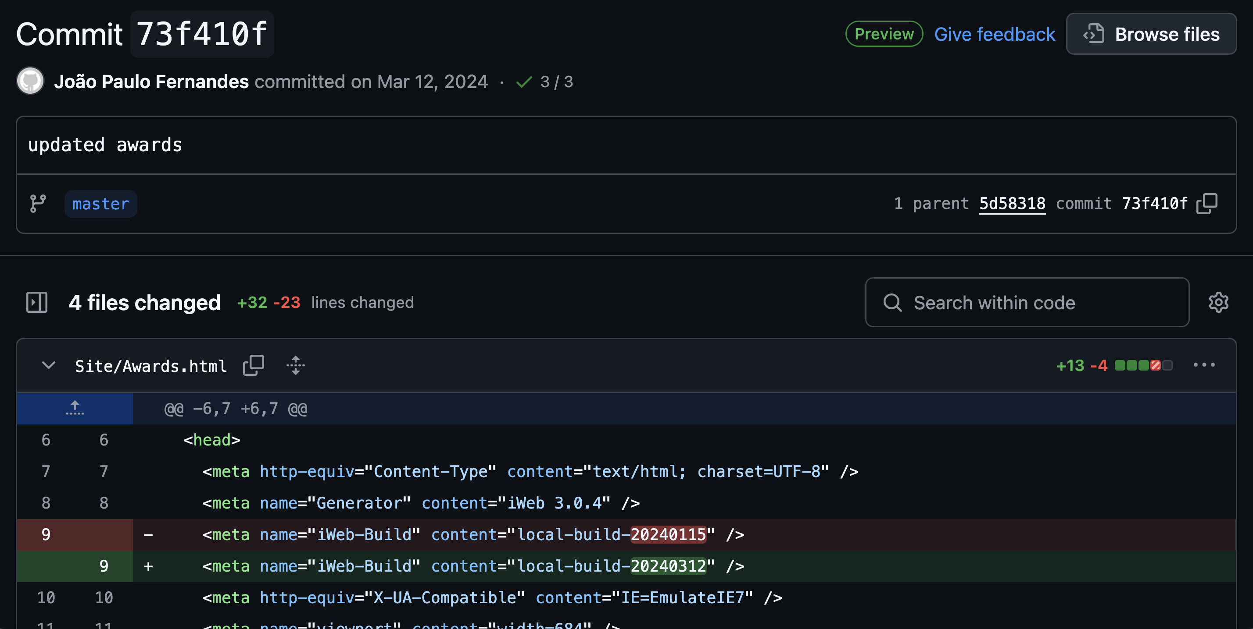
GitHub View of a Commit

Slide 19
When to Commit?
You want to commit often, ideally when you completed a unit of change (but not for every single line)
You don’t want to have “tangled commits” — think of your commits in terms of cohesion. You don’t want to have 10 completely unrelated files with unrelated changes appearing in the same commit
The commit message should also make sense (as much as possible) for all changes in the change set you are committing
Push max. at the end of the day (ideally on your own branch)

Slide 20
In-class exercise: practicing basic usage of git
See file accompanying today’s lecture on Brightspace
We will focus on Exercise 1
You are encouraged to follow the other exercises on your own.
Submit screenshot of the github view of the push solicited in step 5.

Slide 21
Code Review
A technique where developers ask their peers to identify defects in their code before “releasing it”
Code review is a manual process that relies on human judgement
It’s a process for identifying problems that are then reported back to the author of the code. It is not a process of fixing those problems

Slide 22
What to Look For During Code Review ?
Are there any obvious logic errors in the code?
Looking at the requirements, are all cases fully implemented?
Are the new automated tests sufficient for the new code? Do existing automated tests need to be rewritten to account for changes in the code?
Does the new code conform to existing style guidelines?
Is there a more concise/readable/efficient way to implement this?
[https://www.atlassian.com/agile/software-development/code-reviews]

Slide 23
Issue-tracking system
A system that help you record and track progress of any issues in your system
The term “issue” here is general. An issue can be:
A bug
A new feature request
An enhancement
…

Slide 24


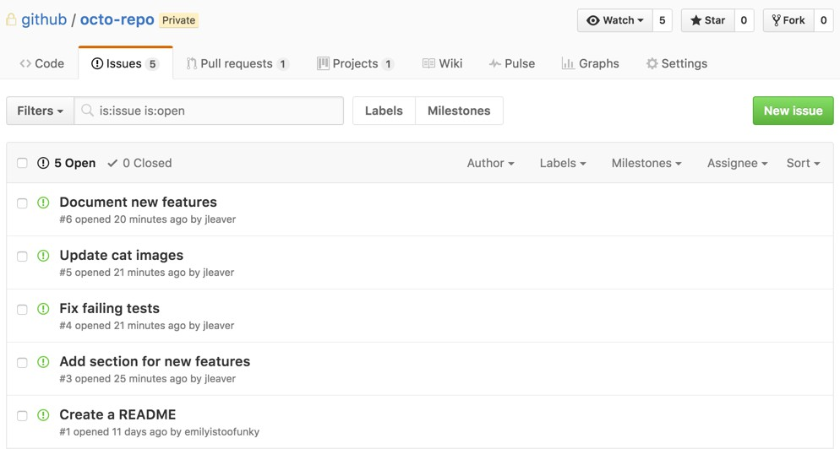
Examples of Issue Tracking Systems
Bugzilla
GitHub Issues

Slide 25
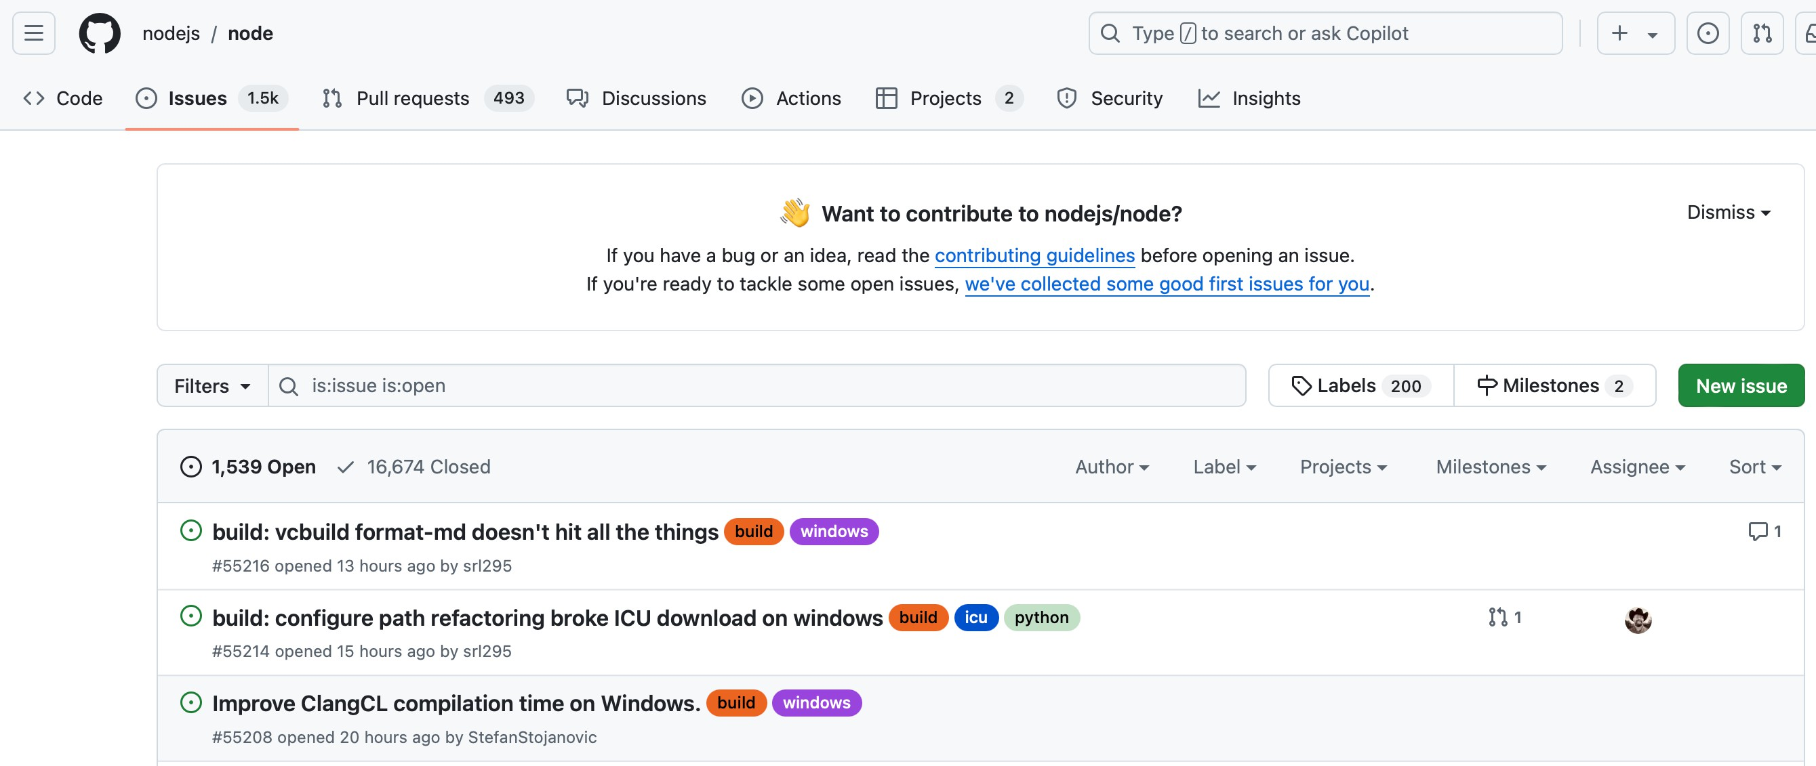
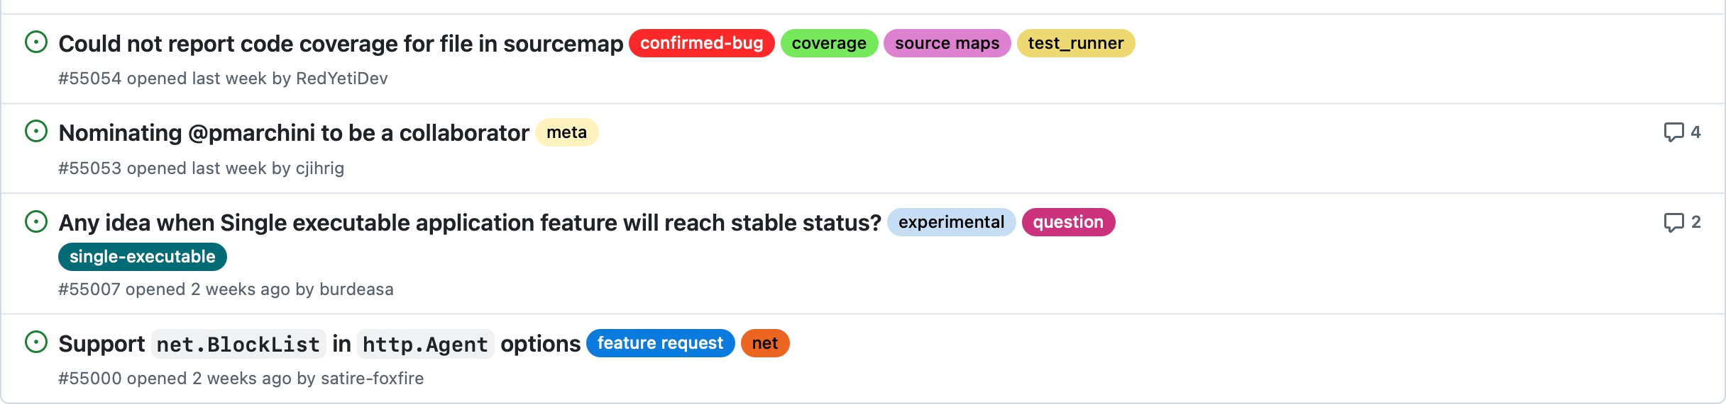
GitHub Issues
…
12

Slide 26
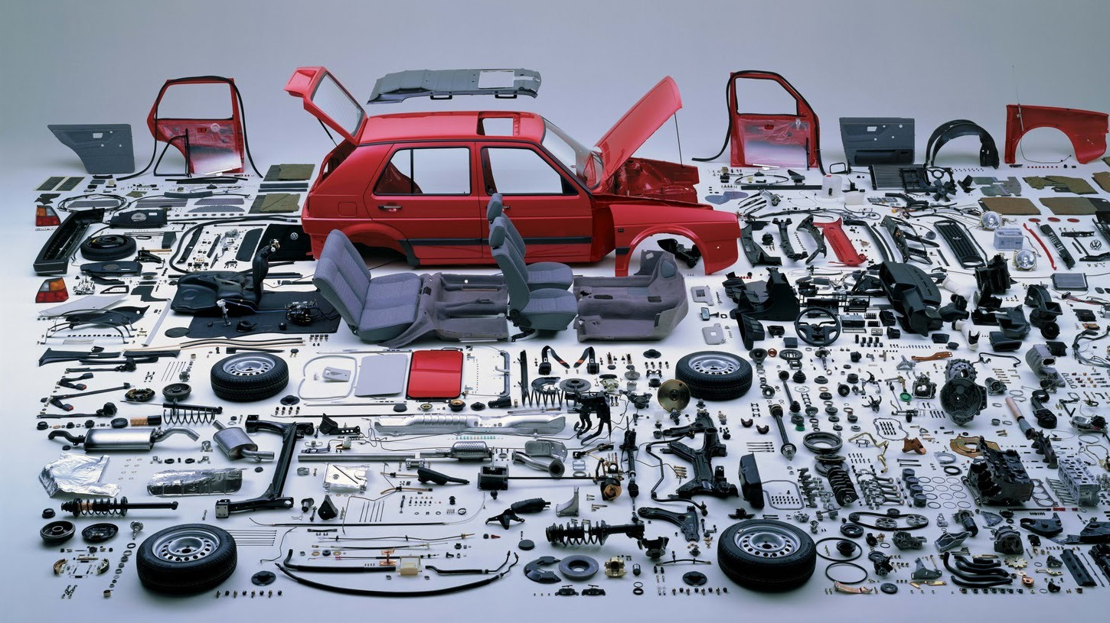



What is a build system?
Source code
Deliverable
© Shane McIntosh
16

Slide 27
Benefits of Build Systems
Allow automated and consistent builds by declaring exact dependencies and exact steps for creating an executable
Facilitate reproducibility
Optimize the build process (often avoiding the recompilation of unchanged code)
Necessary pre-condition for continuous integration and continuous testing

Slide 28



Makefiles for C/C++ programs
program : random.o input.o main.o
<tab>gcc -o program random.o input.o main.o
program
random.o : random.c
<tab>gcc -c random.c
input.o : input.c
<tab>gcc -c input.c
random.o
input.o
main.o
main.o : main.c
<tab>gcc -c main.c
$ make
random.c
input.c
main.c
19
© Shane McIntosh

Slide 29
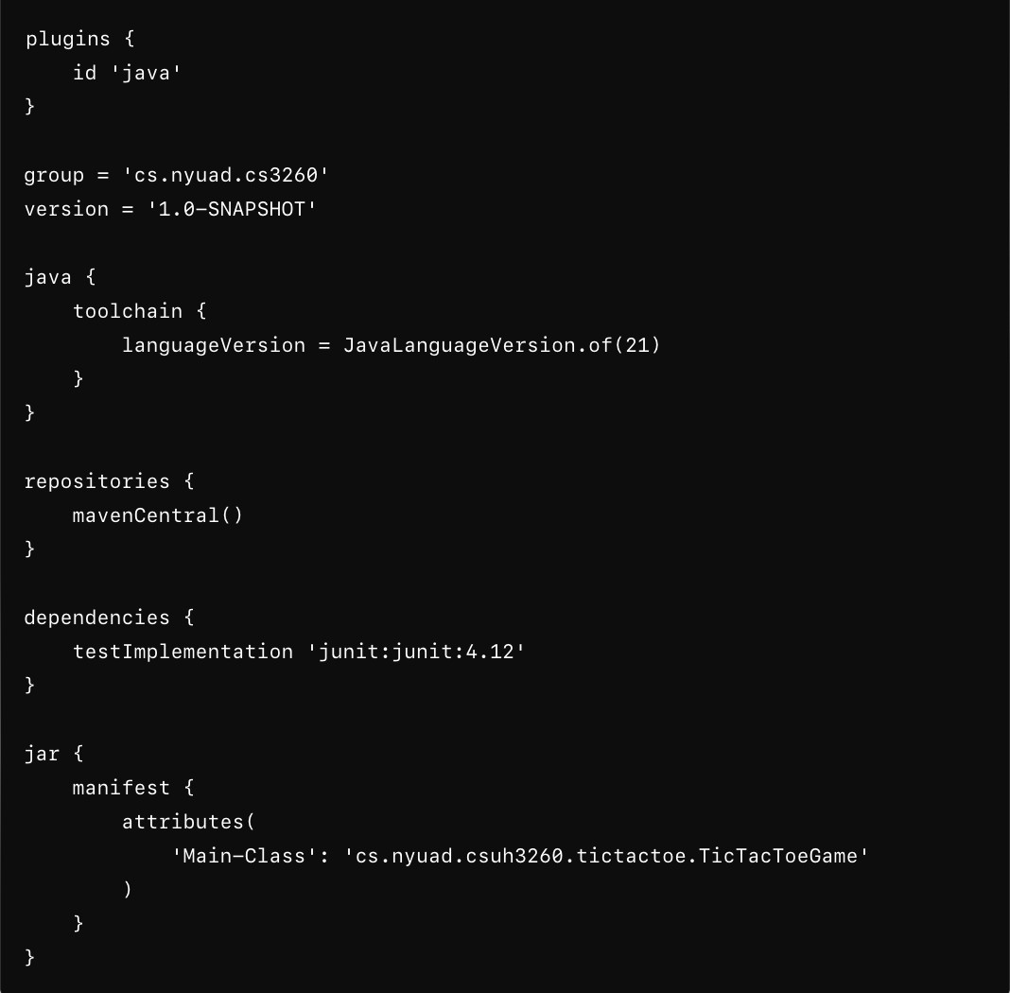
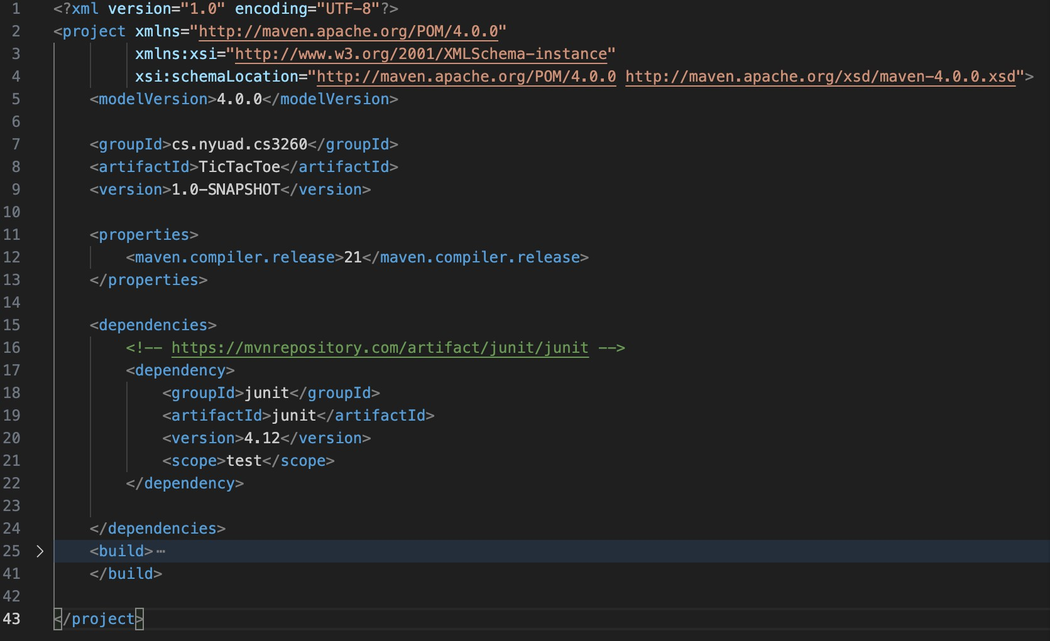
Maven or Gradle for Java Programs
Unique coordinates to identify this project/artifact
Similarly, you need to specify the identifying info for any dependencies you use
Maven pom.xml example file
Gradle build.gradle example file
$ gradle clean build
$ mvn clean package
20

Slide 30
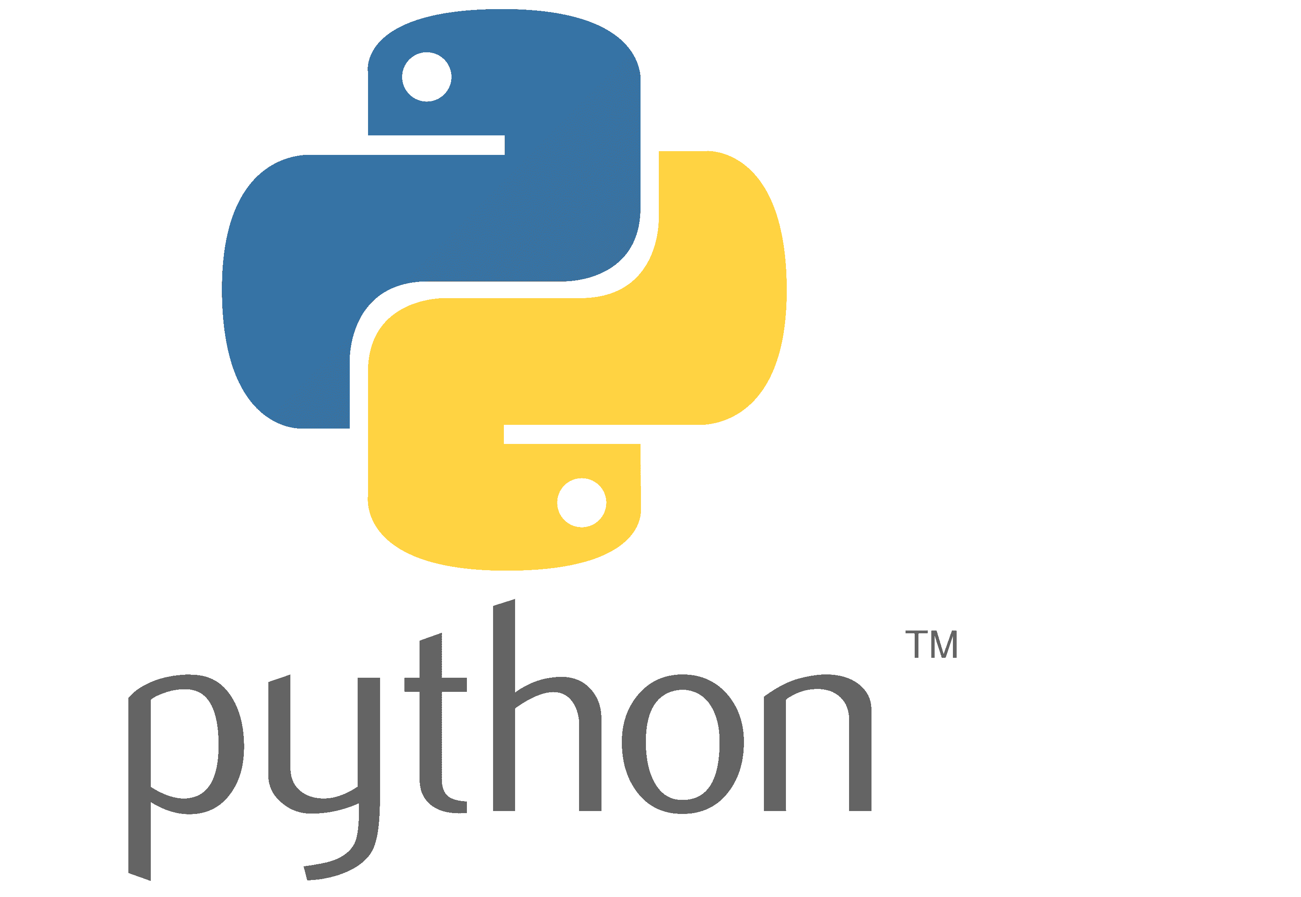
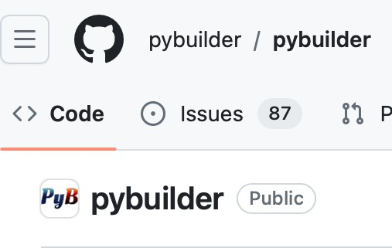
pip + requirements.txt
Only manages dependencies. Don’t forget to specify versions!
Use Python build backends through some project manager (e.g., setuptools, Hatch)
Package your project into a package that can be distributed, run, and used by others
Build automation tool that abstracts away some of the low-level details and setup you need to do
21

Slide 31
Swift build systems and package managers
https://www.swift.org/documentation/server/guides/building.html
https://www.swift.org/documentation/package-manager/
https://developer.apple.com/documentation/xcode/adding-package- dependencies-to-your-app
$ swift build

Slide 32
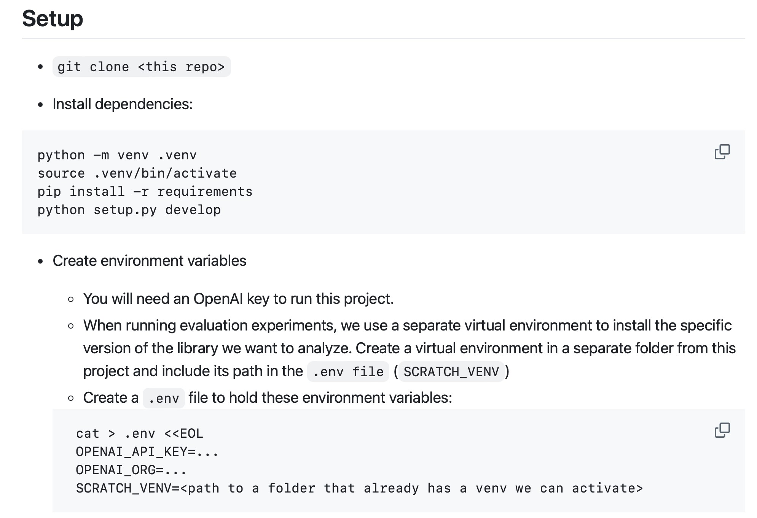
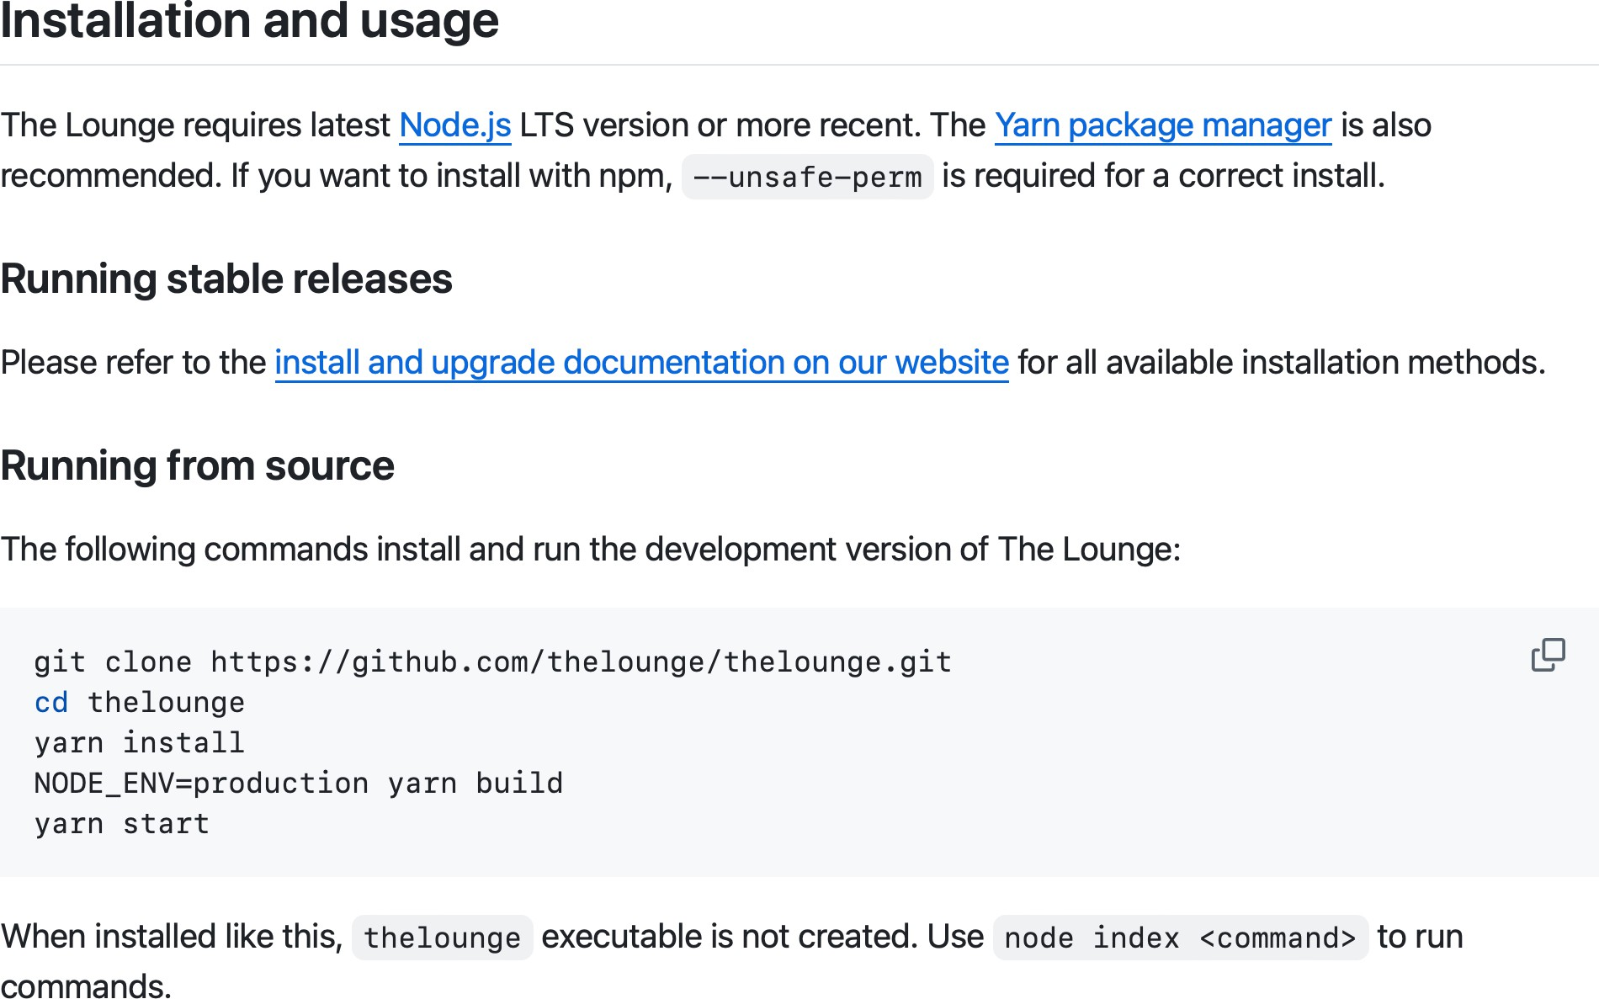
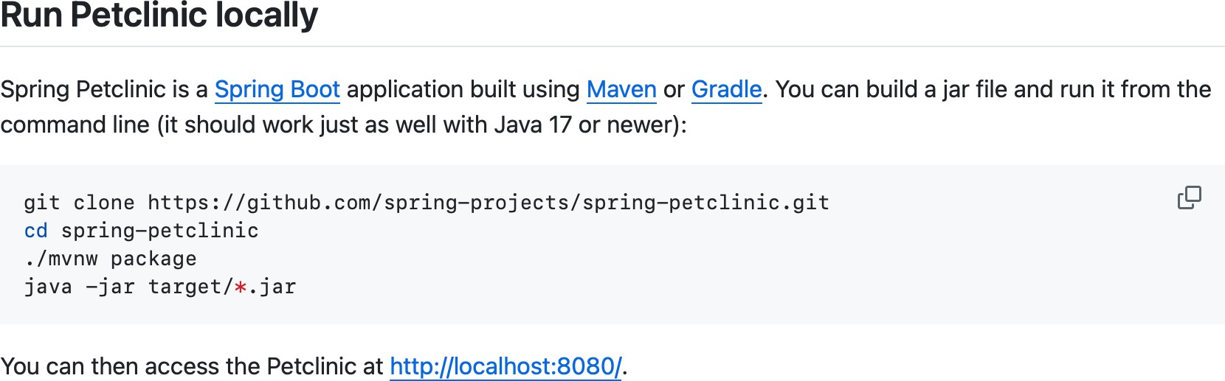
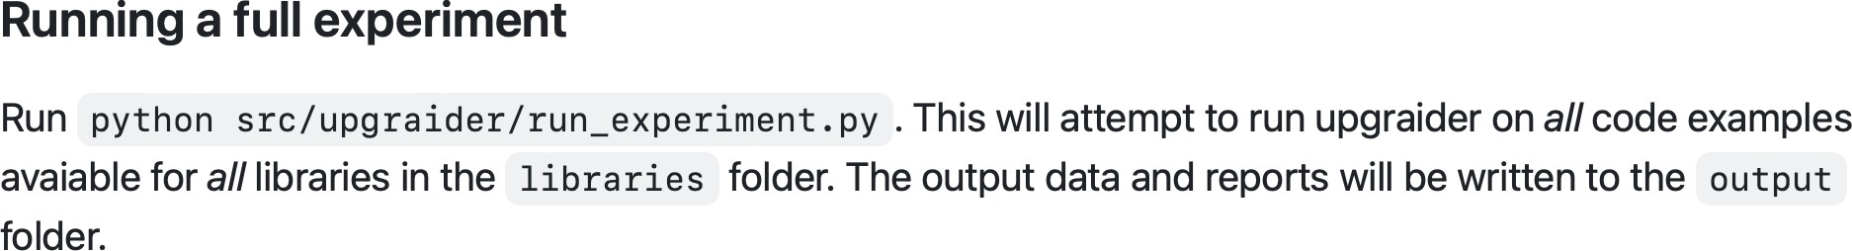
In your final deliverable
We need clear instructions on how (to build and) run your code on the command line. Some examples:
https://github.com/spring-projects/spring-petclinic
https://github.com/thelounge/thelounge#readme
https://github.com/githubnext/Upgraider
Tip: Test your instructions on another machine!

Slide 33

README File
As the name suggests, a file you should read before you proceed
It should tell its reader what this module/project/code is about, what does it look like in action, how to use it/run it, and any other relevant details (e.g., how to contribute)
Makes it easier for others to use this code (even yourself years later!)

Slide 34
Common ReadMe names/extensions
readme or README (latter more common)
No extension, .md, .txt
For GitHub hosted projects, markdown is the best option as it gets automatically rendered, making it more readable

Slide 35
README Contents
Description: what is this project about? Why should I care?
Installation & usage instructions: how do I actually make this work?
Where to get help: Link to the docs, mailing list, wiki, etc.
Contribution guidelines: how can I help out? Are there standards I need to adhere to?
Contributor list: who’s involved in this project?
Badges: visual guides telling the status of your build etc
We expect your final deliverable to have a clear README!
* Bold are the absolute minimum!
[Some content adapted from: https://changelog.com/posts/top-ten-reasons-why-i-wont-use-your-open-source-project]

Slide 36
Example ReadMes
https://github.com/githubnext/testpilot
https://github.com/pandas-dev/pandas
https://github.com/matiassingers/awesome-readme
…

Slide 37
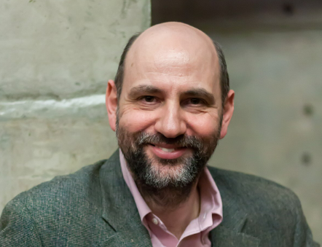
CODE RAFCATORING
Martin Fowler defines refactoring as "the process of changing a software system in such a way that it does not alter the external behavior of the code yet improves its internal structure."

Slide 38

REFACTORING
We can simply define refactoring as "changes to code for improvement."
Since programming has been a discipline for over 50 years there is a long list of tips and tricks that apply here. Also, Object Oriented languages give rise to higher-level improvements at the design level.
Let's classify refactoring into three levels: 1) low 2) medium 3) high.

Slide 39
Low level refactoring
The low level refactorings reflect good, initial coding practices. Or perhaps they are good, "after the fact" coding practices.
For example, you see in your code that you are using the same "magic" number throughout your code.
The number may reflect a maximum value of some sort. The fact that the number is used consistently is adequate for the program's initial version, but would be difficult to change in a later revision.

Slide 40
Medium level refactoring
At this level sections of code are under consideration for improvement.
Duplicate code has been identified as a major source of bugs in a program.
When a section of code needs to be revised, it is easy to make the revision and not realize that the code is duplicated.

Slide 41
Medium level refactoring
Decompose a long method into multiple shorter methods.
Consolidate duplicate code into a common method.

Slide 42
High level refactoring
Refactorings at this level involve object-oriented design principles and patterns.
Decompose a Large Class into Smaller Classes
Extract Superclass
Extract Interface

Slide 43
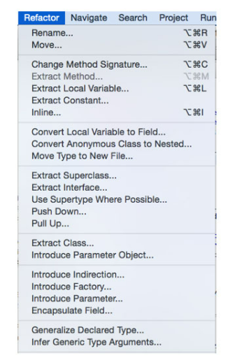
Refactoring- Tools SUPPORT
Software tools within an IDE can automate many refactorings.

Slide 44


Readings , Assignments, Project Tasks
Read: -
Assignments & Project Tasks:
Assignment 2 is due on 4/3. This is an individual assignment.

Slide 45

Questions?

